Slide 1



Abhisarga 2023
GizmoCon
The IoT Hackathon
Stage 2 Prototype Proposal

Slide 2
Flint Works
Leader Name :- Jawadhur Raffiwoo
B.S. ABDUR RAHMAN CRESCENT INSTITUTE OF SCIENCE AND TECHNOLOGY
Member 1 :- Vulli Tejo Vamsi
Member 2 :- Vinit Kumar
Member 3 :- S. Karishma Banu
Leader mail :- mashrafemortaza23072003@gmail.com
Leader Phone number :- 8248157978

Slide 3
If your idea were a tweet
(Abstract)
Globally, around 1.3 MILLION lives are getting lost every year. So, in order to save those countless no.of lives, we must reduce the no. of accidents.
Here's where our ACCIDENT PDAM(PREVENTION, DETECTION, ALERT & MONITORING) system comes and prevents accidents by using the Smart Helmet for two wheelers and DYNAMIC SPEED LIMITER for all Vehicles.
Accident Detection System and Monitoring system, which alerts the emergency contacts and control system immediately after an Accident.
Retrieves the Accident data and has the most accurate database of no.of accidents that are taking place.

Slide 4
Justification and the novelty in the selected topic
SMART HELMET:
Existing smart Helmet model uses only a SINGLE FSR SENSOR At the top of the Helmet.
But our Smart Helmet uses THREE PIEZO SENSORS to increase the accuracy of the existing smart Helmet technology and works more efficiently.
DYNAMIC SPEED LIMITER:
Existing speed limit systems are static. They need MANUAL CHANGE by mechanic each time when there must be change of speed limit.
But making it dynamic is possible and exists in ELECTRIC VEHICLES by uploading a Program code in ECU.
When it comes to IC ENGINE Vehicles dynamically changing speed limit is NOT POSSIBLE with EXISTING MODEL.
Here's where our system has a SELF DESIGNED CARBURETTOR SYSTEM which makes this process automated by taking GOOGLE MAPS ROADS API(GOVERNMENT'S OFFICIAL SPEED LIMIT INFORMATION) and VEHICLE’S PROXIMITY as two input Parameters.

Slide 5
Justification and the novelty in the selected topic
ACCIDENT DETECTION SYSTEM:
EXISTING DetectioWn model uses ACCELEROMETER alone to detect accident. but there are many problem statements that the existing system doesn't satisfy.
Here comes OUR DETECTION SYSTEM which increases the accuracy of detection of accidents.
We detect the DAMAGE happened to the vehicle INDIRECTLY using PRESSURE SENSOR.
DATA RETRIEVAL:
Existing Data Retrieval follows FIRST COME FIRST SERVE(FCFS).
The vehicle that faces an accident gets the services first.
But our system compares it with all other cases or present scenarios and does PRIORITIZATION PROCESS.

Slide 6
Holistic view of the problem (Block Diagram of the entire flow)
Prevention System - Smart Helmet (Block Diagram)
Power Supply
ATMEGA-328
ATMEGA-328
RF Transmitter
RF Receiver
3x Piezoelectric
Vehicle Engine Ignition Ignition Circuit

Slide 7
Holistic view of the problem (Block Diagram of the entire flow)
Carburetor System
ATMEGA-328
Self Designed Carburetor System
Power Supply
Proximity Ultrasonic Sensor

Slide 8
Holistic view of the problem (Block Diagram of the entire flow)
Detection System
Fire Sensor
GPS
ATMEGA-328
Piezoelectric
Power Supply
GSM
Cloud Platform
Accelerometer
MPU6050

Slide 9
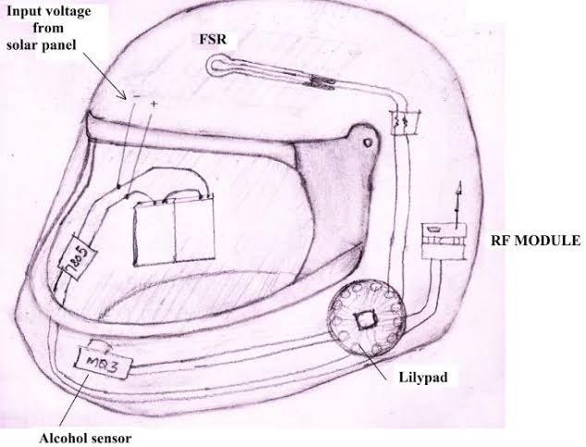
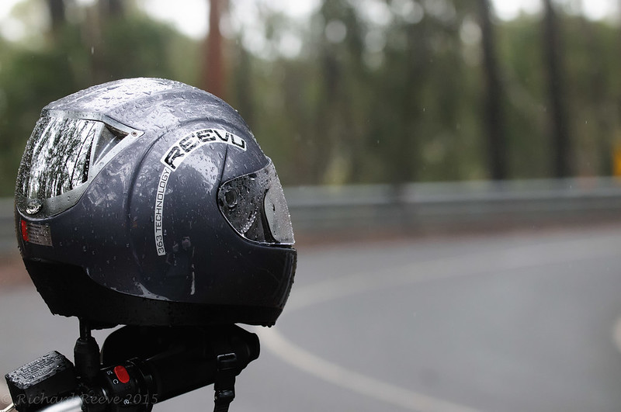
Methodology adapted:
The complete Procedure followed for our Idea is divided into 2 basic section :
Prevention
Detection and Data Retrieval
PREVENTION – The prevention part relies on the usage of SMART HELMETS and DYNAMIC SPEED GOVERNOR for improving the safety parameters while driving.
While riding a bike the smart helmet will send the signal if a person is wearing it or not.
The speed governor is set according to two parameters
Nearby traffic or obstacles.
Speed limit set by the Government for specific Roads.
This methodology ensures to reduce the risk of RASH DRIVING, RIDING WITHOUT HELMET and also ensures that the person travels according to GOVERNMENT SPEED LIMIT NORMS.

Slide 10
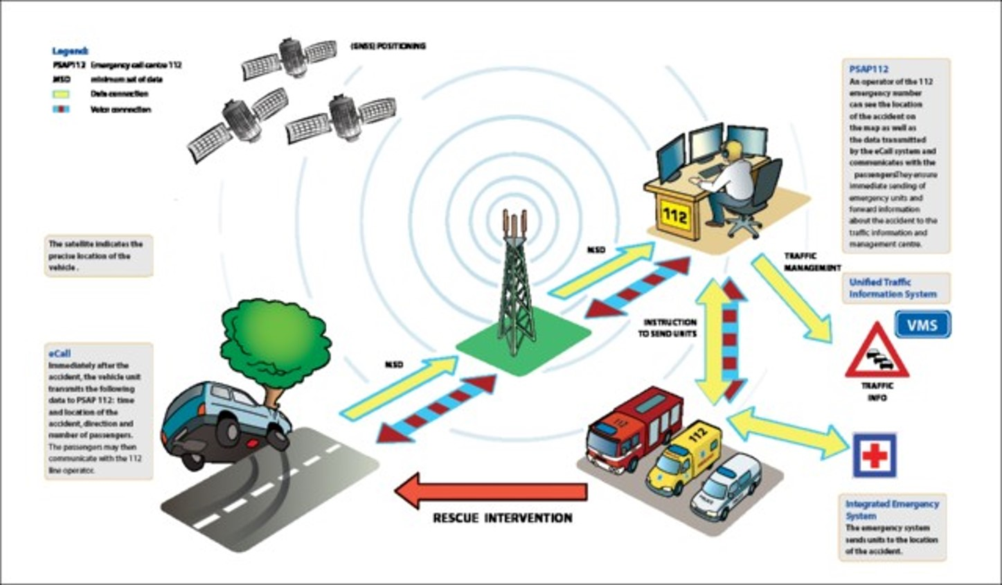
EXISTING MODEL FOR DETECTION OF ACCIDENTS

Slide 11
Methodology adapted Cont…
DETECTION & DATA RETRIEVAL – This methodology is implemented to provide immediate support at the distress location as soon as possible and thus reduce the probability of deaths after accident occurs.
For detection, the PRESSURE SENSOR DATA(for knowing the damage), LOCATION of the accident, FIRE STATUS and NO.OF PEOPLE in the vehicle is sent to the control centre and emergency contacts.
The CONFIRMATION RESPONSE from the driver is asked for any false accident conditions.
Based on severity of the accident using our PRIORATIZATION METHOD and the necessary rescue operations are provided at the accident location.

Slide 12
Functionalities: Hardware and User Interface/Soft modules:
Ex: Hardware modules, Networking (Wi-Fi/Bluetooth) modules, UI, data logging cloud aspects (if any) and Graphs/plots etc.
PREVENTION :- We are going to utilize Smart Helmet (for two wheelers) and Dynamic Speed Governor (for IC Engine) for reducing the probability of Accidents.
Smart Helmet – Modification of existing model.
Piezo Sensor (×3) – To get the pressure data (wearing the helmet or not).
// RF Module – To Transmit the data from Helmet.
MQ3 – Alcohol Sensor to check if a person is sober.
Dynamic Speed Governor – Changing the speed limits of a vehicle according to the government speed limit as well as traffic around a vehicle.
Carburetor – Selg Designed Carburettor System.
Servo – To control the inlet valve for fuel and air inlet.
HC-SR04 – Ultrasonic sensor to identify nearby obstructions or traffic.

Slide 13
Functionalities: Hardware and User Interface/Soft modules:
Ex: Hardware modules, Networking (Wi-Fi/Bluetooth) modules, UI, data logging and Graphs/plots etc.
DETECTION & DATA RETRIEVAL :- We have used system for Detection and Data retrieval for minimizing the future probabilities of accidents.
Detection - To identify for any accidents occurred.
Accelerometer - Sudden change in Speed or Axis of the vehicle.
Pressure Sensor - To improve the Accuracy of detection of Accident by detecting the amount of damage taken to the vehicle
Data Retrieval - To provide life support just after accident as well as storing data for future reference.
GPS and GSM - Location, Data collected from impact, sent directly to control centre for further assistance.
Cloud - To store the data for future reference.

Slide 14
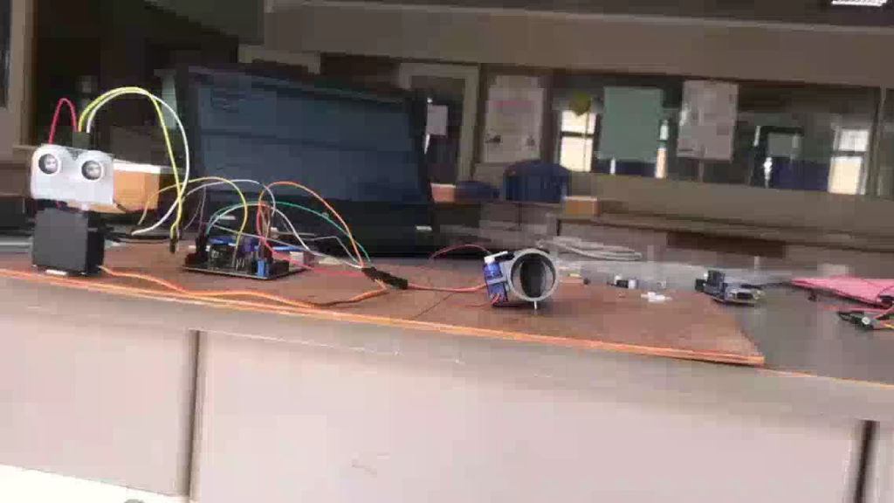
DEMONSTRATION OF PREVENTION MODULE

Slide 15
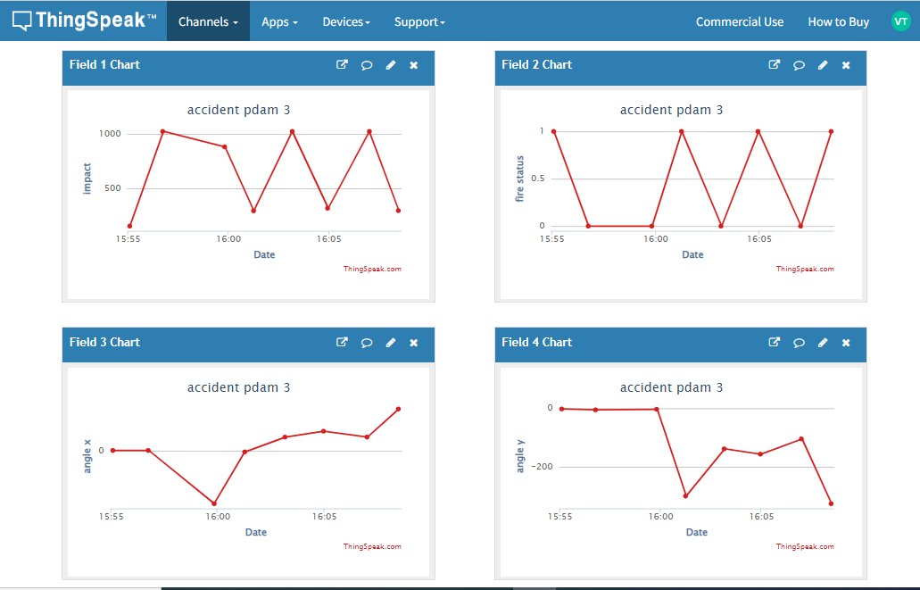
DEMONSTRATION OF DETECTION MODULE

Slide 16
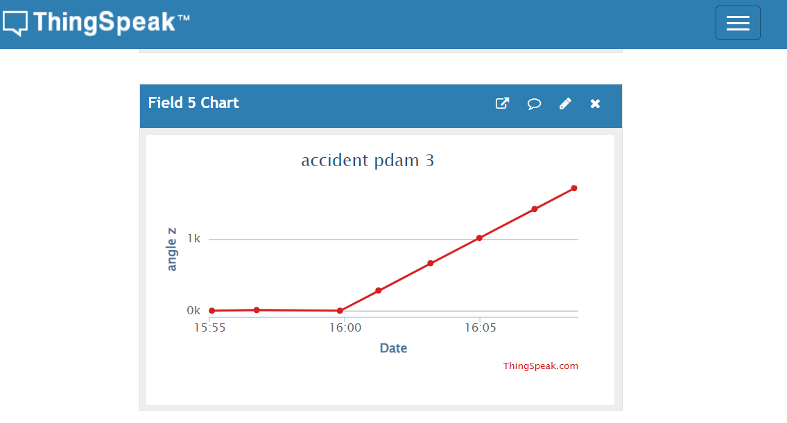
DEMONSTRATION OF DETECTION MODULE

Slide 17
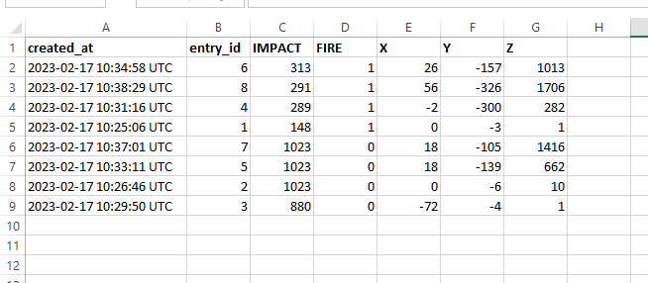
DEMONSTRATION OF DETECTION MODULE

Slide 18




Additional Informations
SUSTAINABLE DEVELOPMENT GOALS

Slide 19
Additional Informations (BENEFITS???)
GOVERNMENT •Government’s EXPENSES on accidents gets lowered •The Government’s TRUSTWORTHINESS increases. •Our proposed system makes the job of TRACKING AND STORING the accident data easier by sharing our database with the Government. | INSURANCE COMPANIES •The TENURE OF CLAIMING keeps on increasing due to the No.of accidents decreasing. The DRIVER’S BEHAVIOUR can be monitored and the INSURANCE CLAIMING PERCENTAGE can
PUBLIC •Public starts feeling SAFE after installing our system in their vehicles. •Doesn’t snatch away FREEDOM of driving fast at empty roads and also due to STATIC SPEED LIMITER. •High Level feature for a LOW COST. | AUTOMOBILE AND RESTORATION INDUSTRIES •DEMAND for the vehicle increases. •Gain Profit due to INCREASE IN SALES. •Restoration Companies gets a LOT OF CUSTOMERS for installing our system. •DEMAND FOR THE SYSTEM also increases.

Slide 20
Statistics And Market Of Connected Vehicle Technology
Split by industry

Slide 21
Thank You

